Slide 1
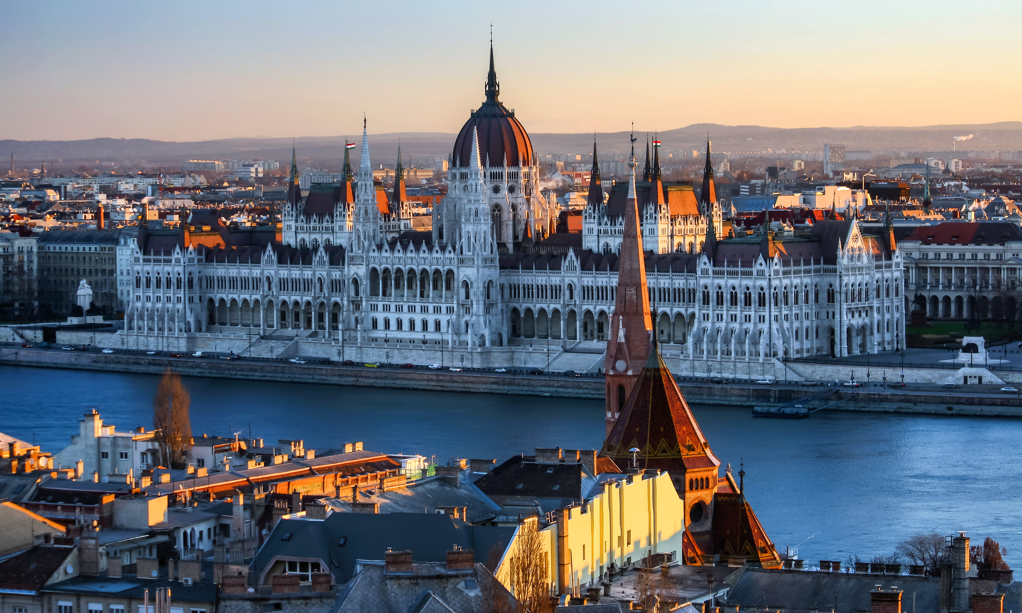
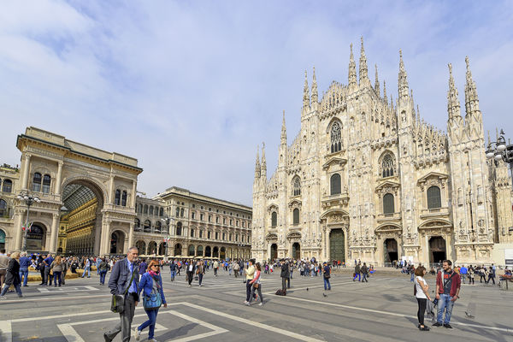
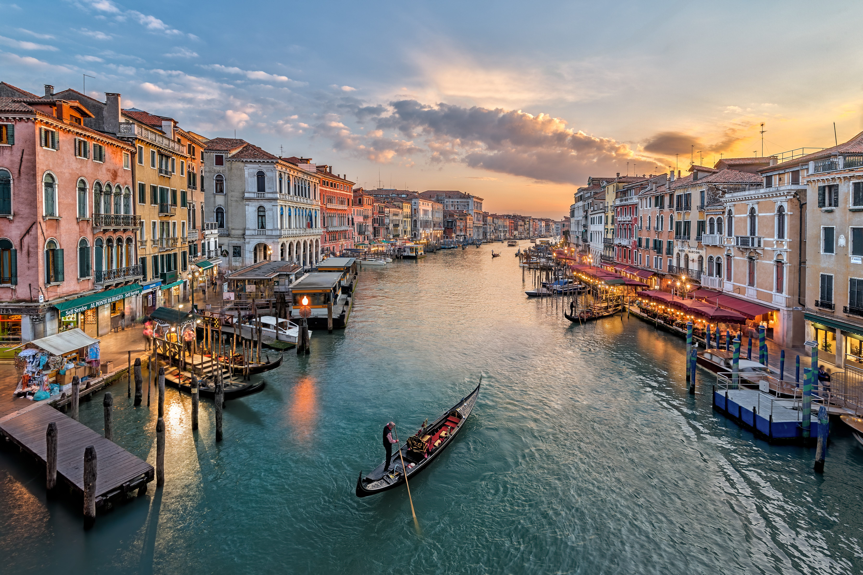
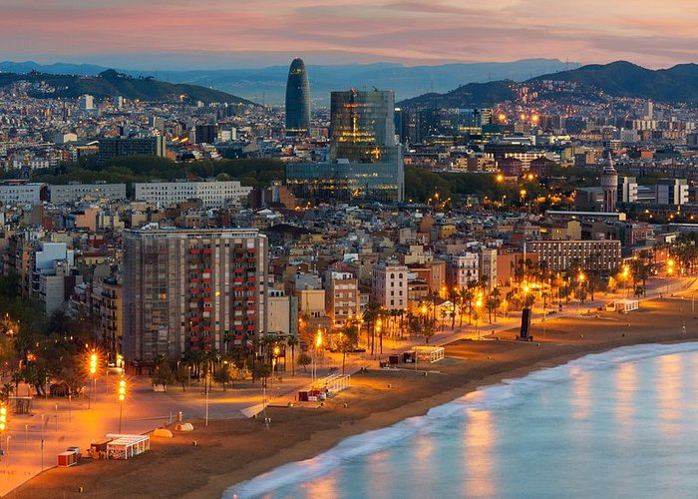
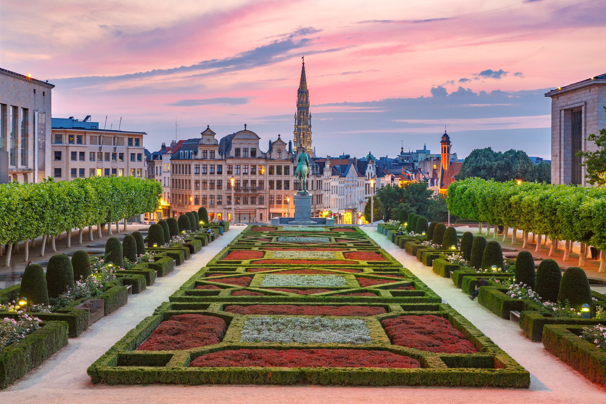
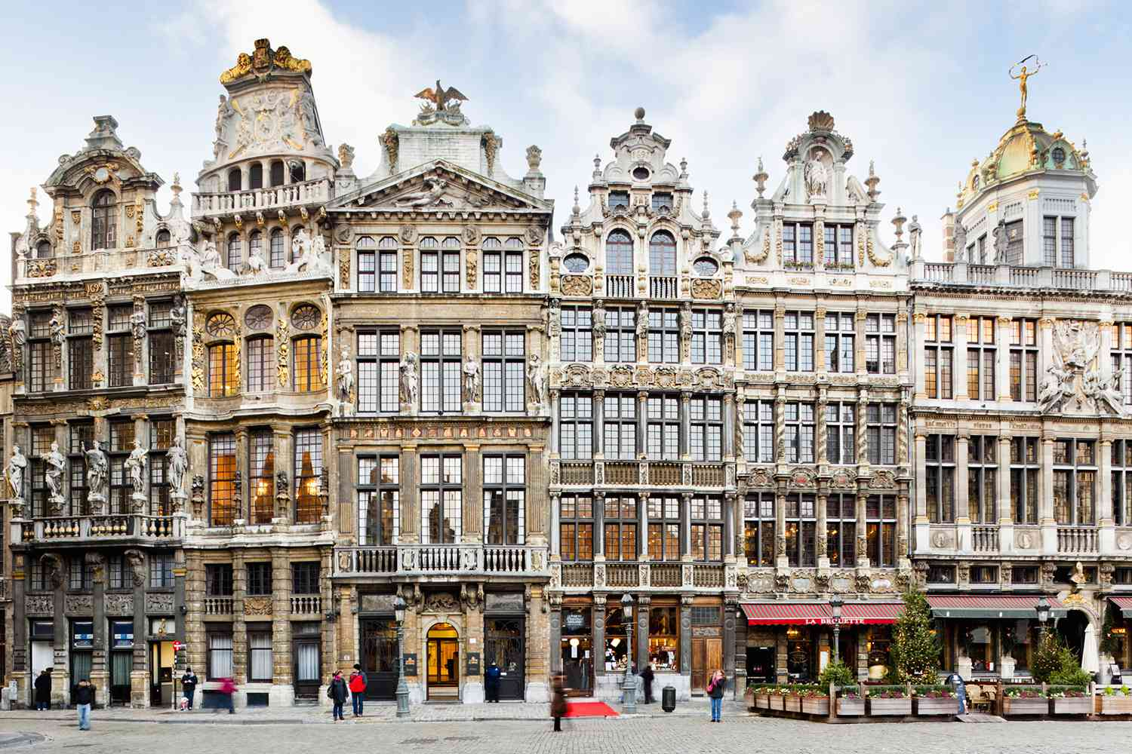
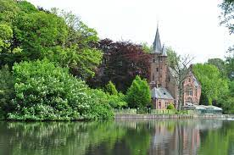
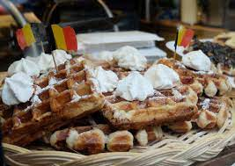
Budapest, HU
Milan, IT
Venice, IT
Barcelona, ES
Brussels, BE
Current Brussels – Temperature = "66" HI = "70" LOW = "60"
Brussels, the capital city of Belgium and the de facto capital of the European Union, is a vibrant and multicultural metropolis. With a population of around 1.2 million, it showcases a fascinating blend of French and Dutch influences due to its bilingual status. Brussels is renowned for its historic charm, stunning architecture, and rich cultural scene, including museums and a thriving arts community. Food lovers can indulge in delicious Belgian cuisine and famous beers. Spanning an area of approximately 161 square kilometers, the city is divided into 19 municipalities. Brussels offers a cosmopolitan atmosphere that seamlessly combines tradition with modernity.
Desktop View
Video

Slide 2
Img
Img
Img
Budapest, HU
Milan, IT
Venice, IT
Img
Img
Tablet View
Barcelona, ES
Brussels, BE
Current Brussels – Temperature = "66" HI = "70" LOW = "60"
Brussels, the capital city of Belgium and the de facto capital of the European Union, is a vibrant and multicultural metropolis. With a population of around 1.2 million, it showcases a fascinating blend of French and Dutch influences due to its bilingual status. Brussels is renowned for its historic charm, stunning architecture, and rich cultural scene, including museums and a thriving arts community. Food lovers can indulge in delicious Belgian cuisine and famous beers. Spanning an area of approximately 161 square kilometers, the city is divided into 19 municipalities. Brussels offers a cosmopolitan atmosphere that seamlessly combines tradition with modernity.
CIty img
CIty img
CIty img
Video

Slide 3
Select Location
Temperature = "66" HI = "70" LOW = "60"
Phone View
Brussels, the capital city of Belgium and the de facto capital of the European Union, is a vibrant and multicultural metropolis. With a population of around 1.2 million, it showcases a fascinating blend of French and Dutch influences due to its bilingual status. Brussels is renowned for its historic charm, stunning architecture, and rich cultural scene.
CIty img
CIty img
CIty img
CIty img
Video

